Slide 1

Water Quality Management and Leakage Detection in Pipeline system
RMK ENGINEERING COLLEGE
ECE THIRD YEAR
N.PAVITHRA 111718106107
P.PRIYADARSHINI 111718106118
S.SAKTHI PRIYA 111718106133

Slide 2

Introduction
This project aims to create a simple and efficient method of water leakage detection and quality management in pipeline systems.
The quality management system encompasses of checking the pH, turbidity, temperature.
Leakage detection is done using a water flow sensor.

Slide 3
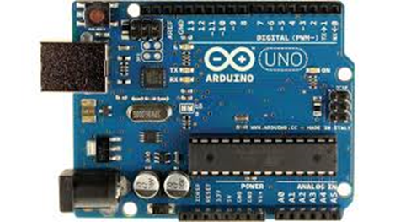
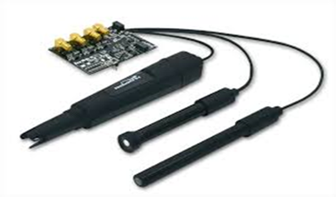
COMPONENTS
Arduino Uno
pH sensor (E-201 PH)
Water flow sensor
16x2 LCD display

Slide 4
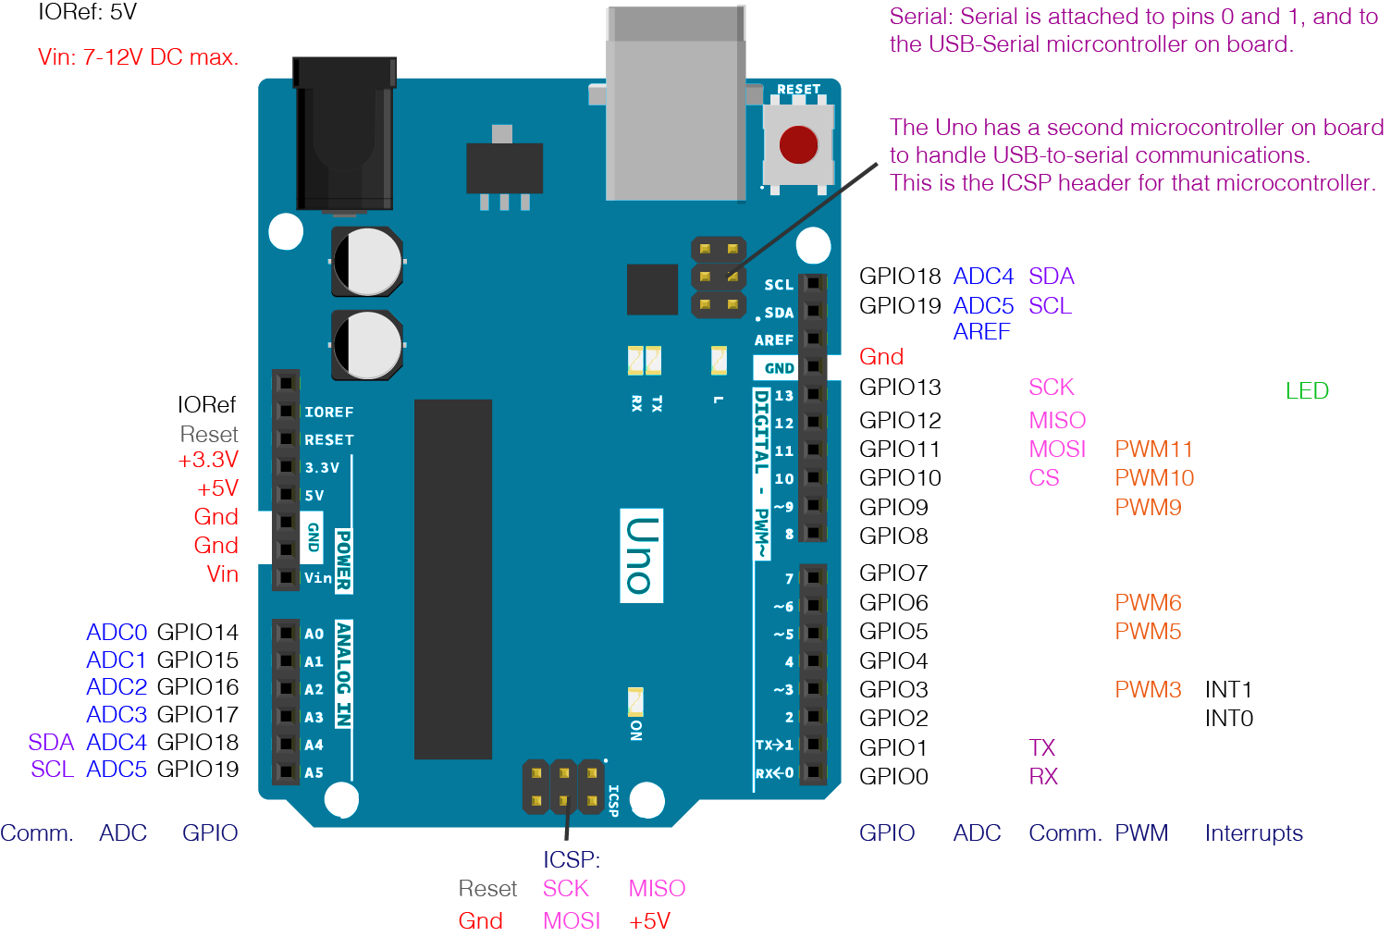
ARDUINO UNO

Slide 5
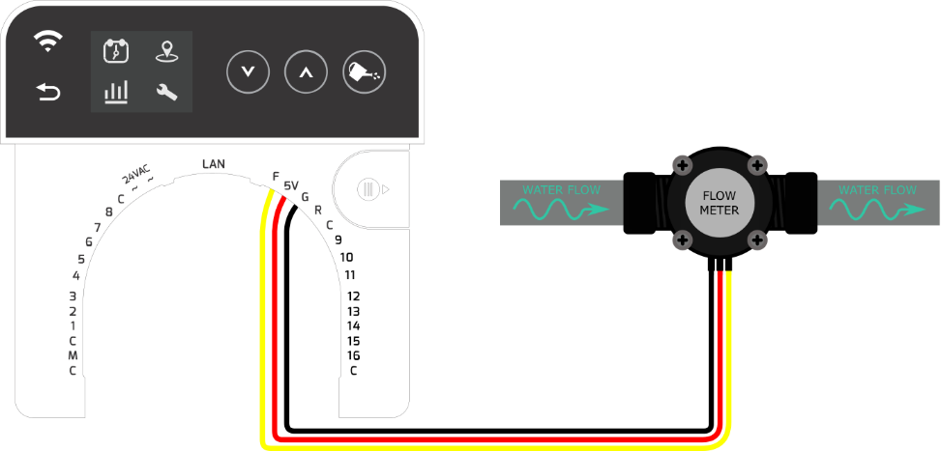
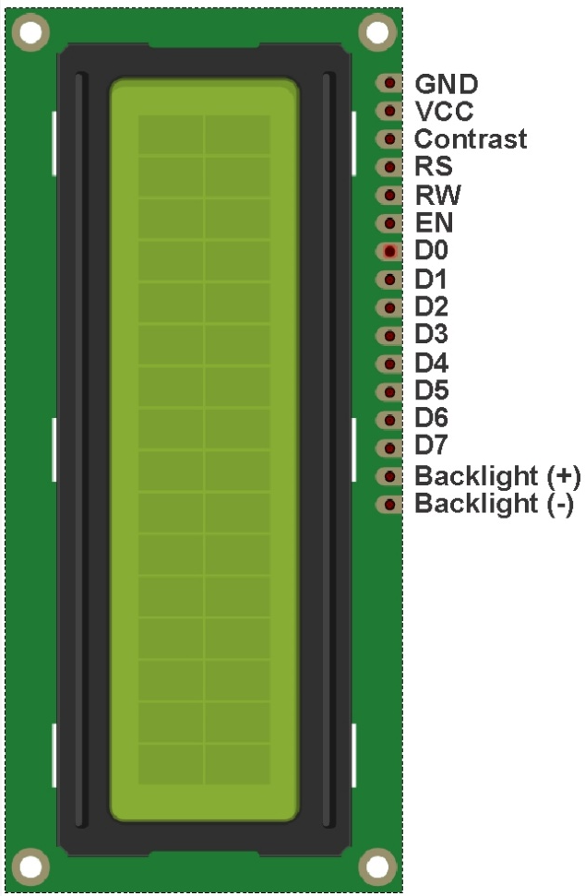
16 X 2 LCD
FLOW SENSOR

Slide 6
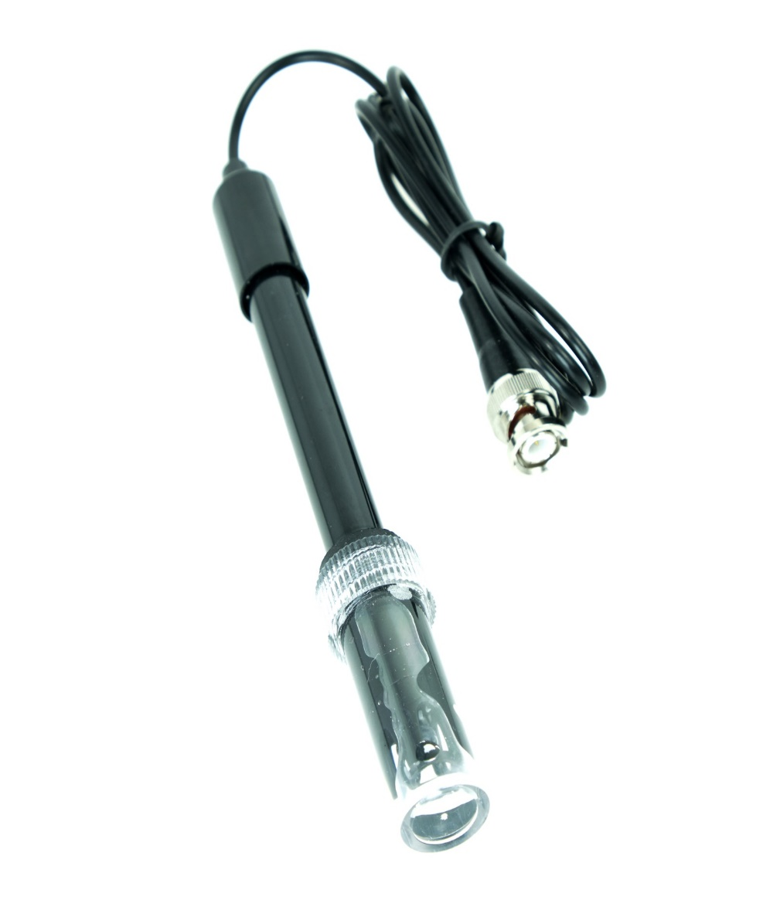
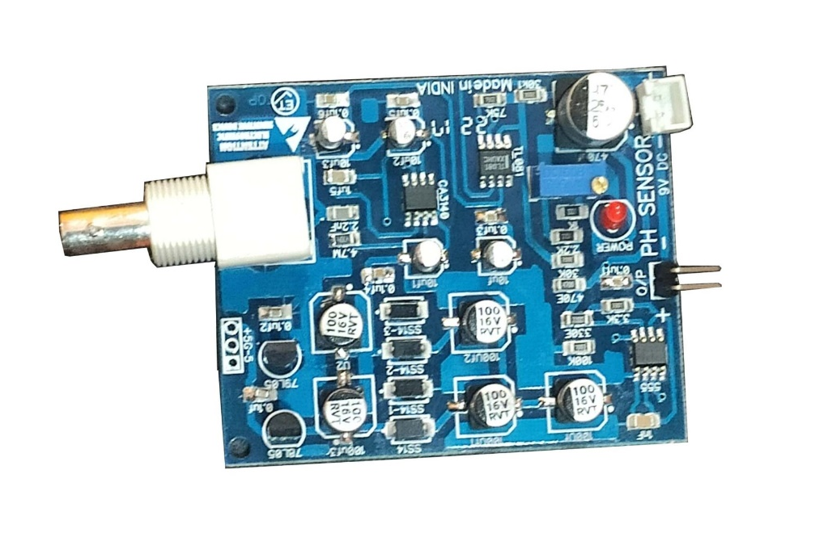
PH SENSOR

Slide 7
Working Principle
pH >7 or pH<7
WATER RESERVOIR
pH = 7
INDUSTRIAL USAGE
DRINKING WATER
IF FLOW SENSOR DETECTS LEAKAGE
ELSE
NOTIFIED USING LCD AND BUZZER
WATER IS SUPPLIED

Slide 8

Working
Initially the pH sensor and the turbidity sensor is placed in the water reservoir. If the pH of the water is not equal to 7 then the water is send for industrial purposes.
Else the water is supplied for domestic purposes through pipelines. These pipes are fitted with water flow sensor to detect leakages. If the flow is more than the threshold value, it would indicate a leakage using the LCD and buzzer .
These flow sensor can be placed for every 100m and hence the place of leakage can also be known using GPS.

Slide 9
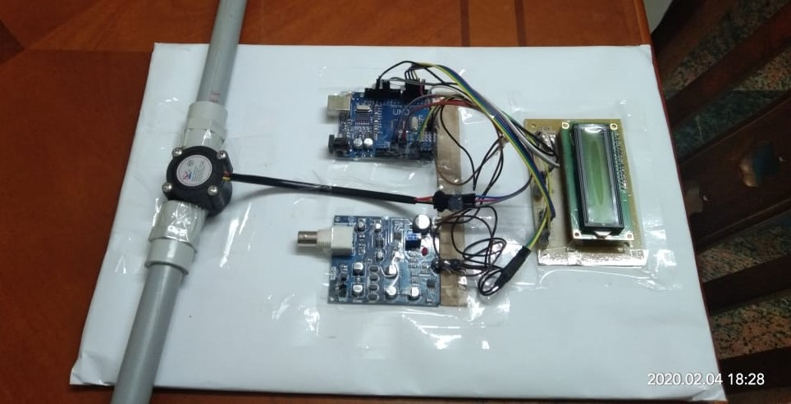
The interface used here is an Arduino microcontroller which collects the input signals from the sensors and accordingly relays them to the LCD or buzzer.

Slide 10
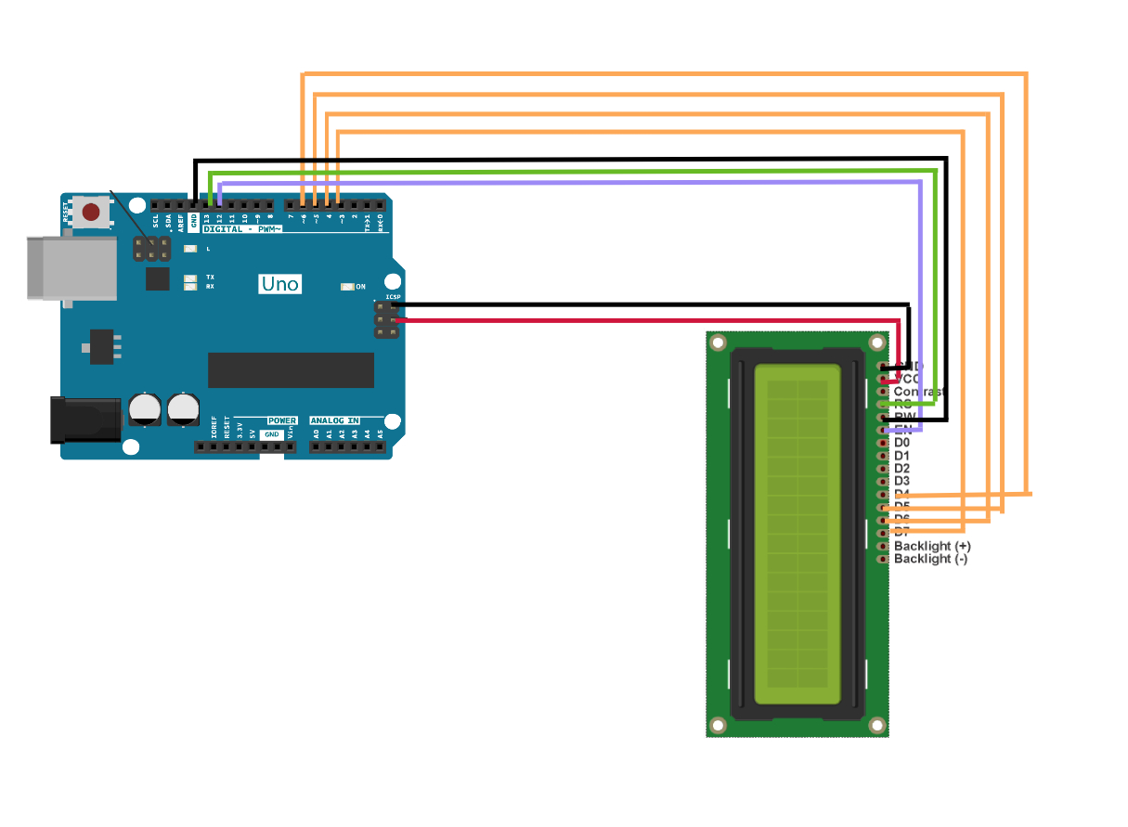
ARDUINO AND LCD INTERFACE
LCD | ARDUINOUNO
D4 | 6
D5 | 5
D6 | 4
D7 | 3
RS | 12
RW | G
E | 11

Slide 11
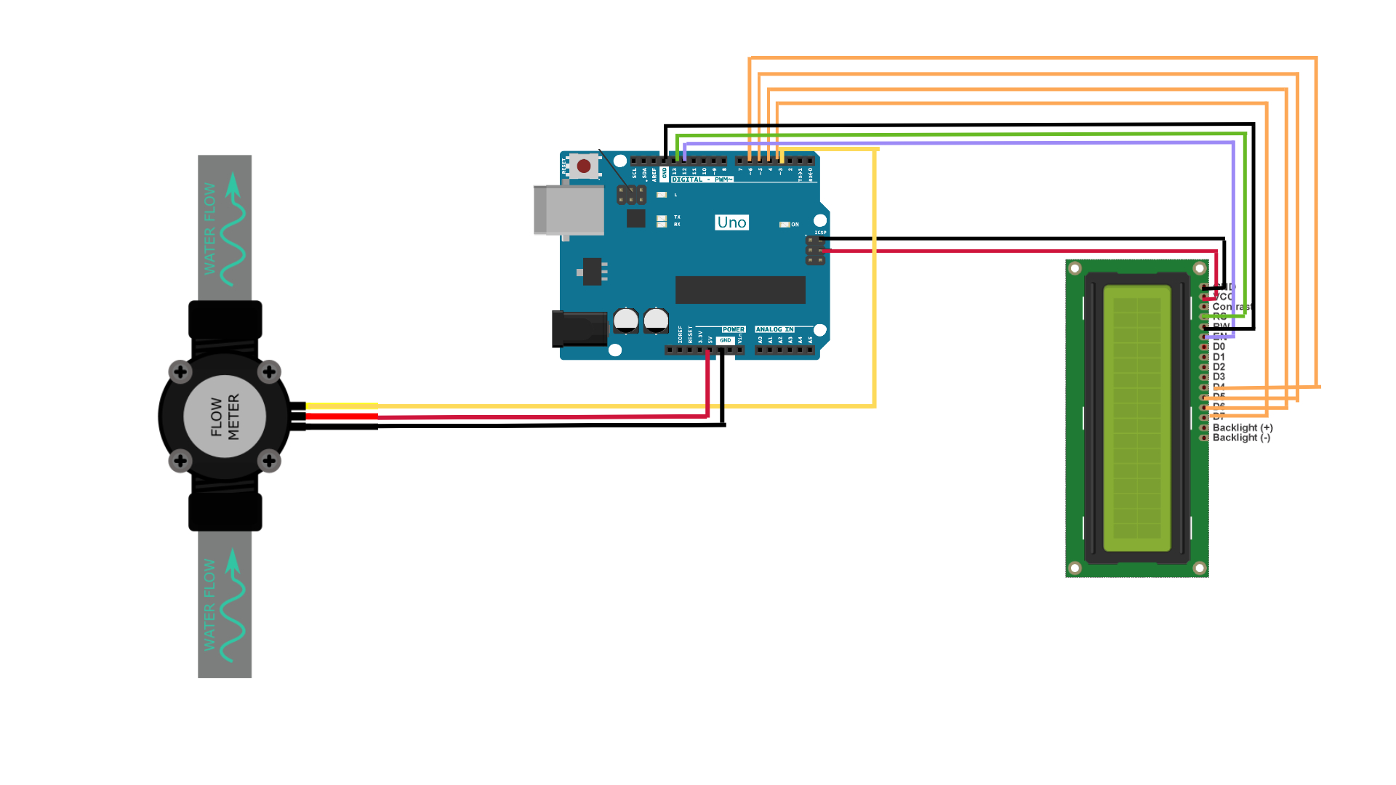
ARDUINO AND FLOW SENSOR
FLOW SENSOR | ARDUINO UNO
GROUND | GND
SUPPLY | +5V VCC
SIGNAL | 2

Slide 12
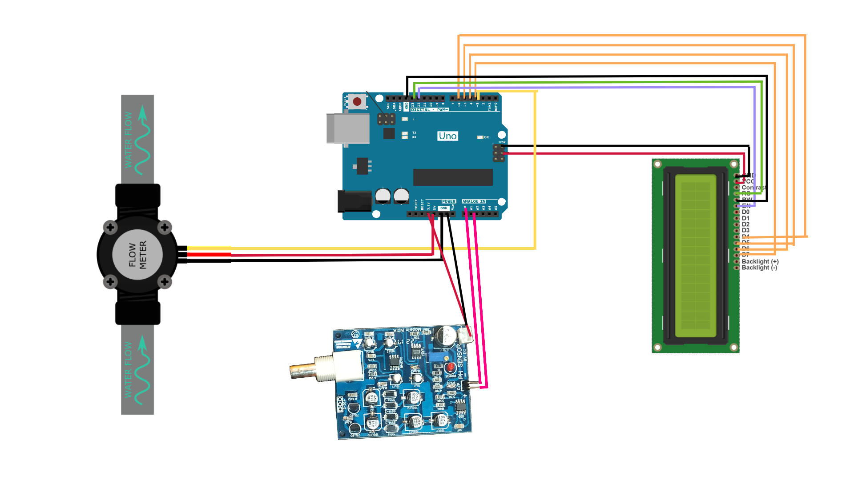
ARDUINO AND PH SENSOR

Slide 13
COST
COMPONENTS | COST
ARDUINO UNO | Rs. 500
PH SENSOR | Rs. 1200
FLOW SENSOR | Rs. 300
LCD | Rs.300
EFFECIENCY
This is a cost effective project.
Can be used in both domestic and industrial purpose.

Slide 14
FUTURE WORK SCOPE
This project can be extended into efficient water management system in local area.
A motor will be attached to the water pipe and it will control water flow, thus helps in reducing water consumption.
In future additional budget is required for further improvement in overall system.
We can also work on making mobile application for remote water monitoring which user can install and download on their device and can get real time notifications.
In future instead of this flow sensor which was used and has the capacity of measuring 30ml litters of water, we would make another model which will measure 60 mile litters of water accurately.

Slide 15


CONCLUSION
This project presents a simple and efficient solution to one of the major problems currently–water crisis.
Detection of leakages in underground pipeline systems is difficult, this makes the problem easier to rectify.

